Slide 1
CSS - 3
Pravinkumar R. D.

Slide 2
CSS Overview
Core Concepts
Implementation Basics
Examining Syntax.

Slide 3
Cascading Style Sheets
http://www.w3.org/TR/CSS21/
Abstract –
This specification defines Cascading Style Sheets, level 2 revision 1 (CSS 2.1). CSS 2.1 is a style sheet language that allows authors and users to attach style (e.g., fonts and spacing) to structured documents (e.g., HTML documents and XML applications). By separating the presentation style of documents from the content of documents, CSS 2.1 simplifies Web authoring and site maintenance.

Slide 4
Cascading Style Sheets
http://www.w3.org/TR/CSS/
Abstract –
This section is non-normative. CSS Level 3 builds on CSS Level 2 module by module, using the CSS2.1 specification as its core. Each module adds functionality and/or replaces part of the CSS2.1 specification. The CSS Working Group intends that the new CSS modules will not contradict the CSS2.1 specification: only that they will add functionality and refine definitions. As each module is completed, it will be plugged in to the existing system of CSS2.1 plus previously completed modules.

Slide 5
Cascading Style Sheets
http://www.w3.org/Style/CSS/

Slide 6
Implementation Basics
Inline CSS
<div style=“color: #000066”><div>

Slide 7
Implementation Basics
Document level CSS
<head>
<style>
div{
color: #000066;
}
</style>
</head>

Slide 8
Implementation Basics
External CSS File
/* iTechy.css */
div{
color: #000066;
}
<head>
<link rel=“stylesheet” href=“iTechy.css” />
</head>

Slide 9
Examining Syntax
Formatting –
div {color: #000066;}
div {
color: #000066;
}
div
{
color: #000066;
}

Slide 10
Examining Syntax
IDs and Classes –
#DivID {
color: #000066;
}
.divClass {
color: #FFFFFF;
}

Slide 11
CSS3 – Contents
Introduction to Fonts.
Introduction to Selectors.
Introduction to Form Inputs.

Slide 12
Introduction to Fonts
Giving Text a new look/image.

Slide 13
Adding a new Font
@font-face {
font-family: FontNameOfYourChoosing;
src: url(‘font.woff’) format(‘woff’);
… optional url fallbacks …
…optional font –stretch –style –weight…
}

Slide 14
Using a New Font
body{
font-family: FontNameOfYourChoosing;
/* or comma separated list of fonts
for fallback support */
}

Slide 15
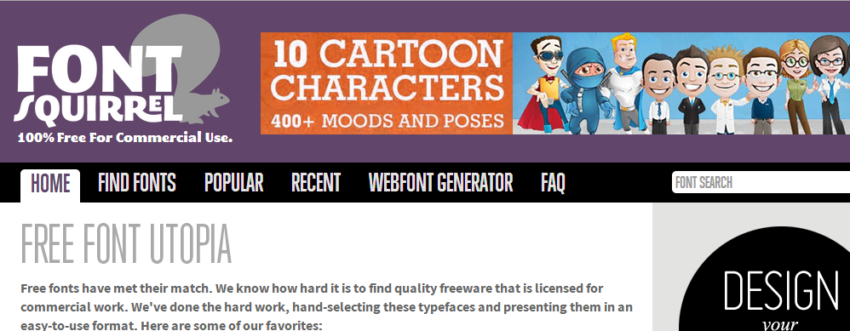
Obtaining Fonts

Slide 16
Text Shadow
div {
text-shadow: 2px /* Horizontal */
2px /* Vertical */
4px /* blur */
#000066; /*color of Shadow*/
}
h1{
text-shadow: -4px -4px 2px #000066;
}

Slide 17
Selectors
How to identify which contents to be styled?

Slide 18
Selectors
:first-of-type [attr^=value] :root
:last-of-type [attr$=value] :empty
:only-of-type [attr*=value] :target
:nth-child(#) :not(…)
:nth-last-child(#) ::selection
:nth-of-type(#)
:nth-last-of-type(#)
:last-child

Slide 19
Form Inputs – Selectors of State
:enabled ::-webkit-input-placeholder
:disabled :-ms-input-placeholder
:checked :-moz-placeholder
:valid
:invalid
:optional
:required

Slide 20
CSS3 – Layout
Layout.
Background.

Slide 21
Layout
How to position the contents and where it should go?

Slide 22
Table Layout
#externalDiv {
display: table;
}
#firstChild,
#secondChild {
display: table-cell;
}
#firstChild
#secondChild

Slide 23
Box Layout
#content {
display: box;
}
#content > nav {
box-ordinal-group: 1;
}
#content > article {
box-ordinal-group: 2; box-flex: 1;
}
#content > aside {
box-ordinal-group: 3;
}
nav
article
aside

Slide 24
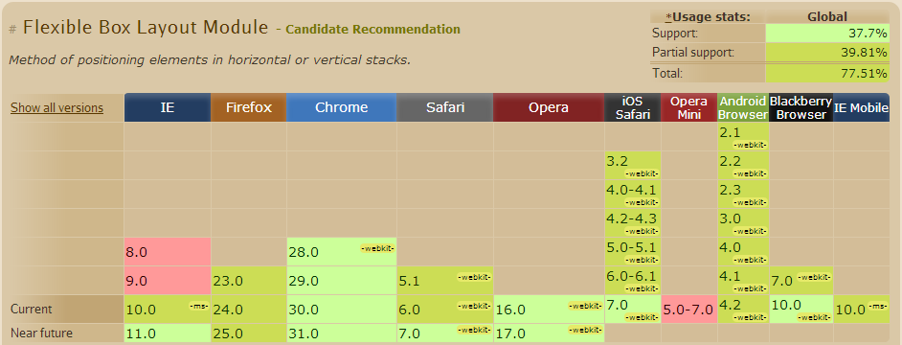
Vendor Prefix
#content {
display: -webkit-box;
display: -moz-box;
display: -ms-box;
display: box;
}

Slide 25
Columns
article:first-child > p {
column-count: 3;
}
article:last-child>p {
column-width: 120px;
}
/* use column-gap to control the spacing*/

Slide 26
Background – Multi-Image
div {
background: url(circle1.png), /*Above*/
url(circle2.png), /*middle*/
url(circle3.png), /*below*/
#000066; /*under all images*/
}
Circle1
Circle2
Circle3

Slide 27
CSS3 – Colors
Opacity
RGBA
Gradients

Slide 28
Opacity
The degree to which you don’t want to see something.

Slide 29
Opacity and Transparency
.fading {
opacity: 0.75;
}
.vanished {
color: transparent;
}

Slide 30
RGBA
.darkCloud {
color: #555555;
/* R=55 B=55 G=55 */
}
.smokey {
color: rgba(85, 85, 85, 1);
}

Slide 31
A for Alpha
.vanished {
color: transparent;
}
.invisible {
color: rgba(0, 0, 0, 0);
}

Slide 32
Current Color
div {
color: red;
border: 5px solid currentColor;
}

Slide 33
Gradients
Blending colors was never so much easy.

Slide 34
Gradients
.lineraGroovy {
background: #FFFFFF; /* Fallback */
background: -webkit-linear-gradient
(#FF5555, #000066);
background: -ms-linear-gradient
(bottom, #FF5555 50%, #000066 50%);
background: linear-gradient
(#FF5555, #000066);
}

Slide 35
CSS3 – Borders
Resizable
Rounded Corners
Shadowing

Slide 36
Resizable
.box {
resize: both; [none | horizontal | vertical]
overflow: auto; [|visible]
max-width: 600px;
max-height: 400px;
cursor: move;
}

Slide 37
Rounded Corners
.divCorners {
border-radius: 5%;
}
.divCorners {
border-radius: 2em;
}
.divCornersAnother{
border-top-left-radius: 2em;
border-top-right-radius: 2em;
border-bottom-left-radius: 2em;
border-bottom-left-radius: 2em;
}

Slide 38
Shadowing
.downRightShady {
box-shadow: 4px 4px #000000;
}
.upAndLeftShady {
box-shadow: -4px -4px #000000;
}
.shadyWithFade {
box-shadow: 4px 4px 10px #000000;
}
.glowing {
box-shadow: 0 0 10px 5px #440066;
}

Slide 39
Complex Box Shadow
box-shadow:
0 0 1em 0.5em #000000, /* all sides */
3em -3em #FF0000, /* upper right */
3em 3em 1em #00FF00, /* lower right */
-3em 3em #FFFF00, /* lower left */
-3em -3em 4em #00FF00, /* upper left */

Slide 40
CSS3 – Transforms
Rotate
Skew
Scale
Translate

Slide 41
Rotate
.tilt {
transform: rotate(15deg);
}
.upsideDown {
transform: rotate(180deg);
}

Slide 42
Skew
.twisted {
transform: skew(30deg, 30 deg);
}
.leanBackLeft {
transform: skewX(30deg);
}
.stretchUpRight {
transform: skewY(150deg);
}

Slide 43
Scale [ZOOM]
.miniMe {
transform: scale(0.5);
}
.twiceAsNice {
transform: scale(2);
}
.instantDiet {
transform: scaleX(0.75);
}
.suddenlyTaller{
transform: scaleY(1.25);
}

Slide 44
Translate
.moveRight {
transform: translate(3em);
}
.toTheLeft {
transform: translate(-3em);
}
.downToTheRight {
transform: translate(3em, 3em);
}
.movinOnUp {
transform: translateY(-3em);
}

Slide 45
CSS3 – Animations
Animations
Transitions

Slide 46
Animation
@keyframes colorAnimation {
from {background: #dddddd;}
to {background: #ff9999;}
}
@keyframes colorAnimation {
0% {background: #dddddd;}
100% {background: #ff9999;}
}

Slide 47
Animation
@keyframes colorsAnimation {
0% {background: #FFFFFF;}
25% {background: #dddddd;}
50% {background: #aaaaaa;}
75% {background: #777777;}
100% {background: #000000;}
}
#targetToAnimate {
animate: colorsAnimation 10s;
}

Slide 48
Animation
@keyframes colorsAnimation {
0% {background: #FFFFFF;}
25% {background: #dddddd;}
50% {background: #aaaaaa;}
75% {background: #777777;}
100% {background: #000000;}
}
#targetToAnimate {
animate: colorsAnimation 10s infinite alternate;
}

Slide 49
Transitions
.changeBack {
transition: background 2s;
}
.changeBack {
background: #FFFF00;
}

Slide 50
Transitions
.changeBack {
transition: background, width 2s;
}
.changeBack {
background: #FFFF00;
width: 200px;
}

Slide 51
Transitions
.changeBack {
transition: all 2s;
}
.changeBack {
background: #FFFF00;
width: 200px;
}

Slide 52
CSS3 – Media Queries
Overview of Responsive Design
Adjusting styles based on viewing dimensions
Adjusting styles based on device constraints

Slide 53
Media Queries – Viewing Area
@media screen and (max-width: 600px) {
.theView {
background: #dddddd;
}
}
@media screen and (min-width: 600px) and (max-width:900px) {
.theView {
background: #ffffaa;
}
}

Slide 54
Media Queries – Device Constraints
@media screen and (max-device-width: 480px) {
.theView {
background: #000000;
}
}

